Slide 1

2022 Winter
UPDATA AI Study
Chap 2. Unimformed search
Image from CS188 of Klein and Abbee

Slide 2
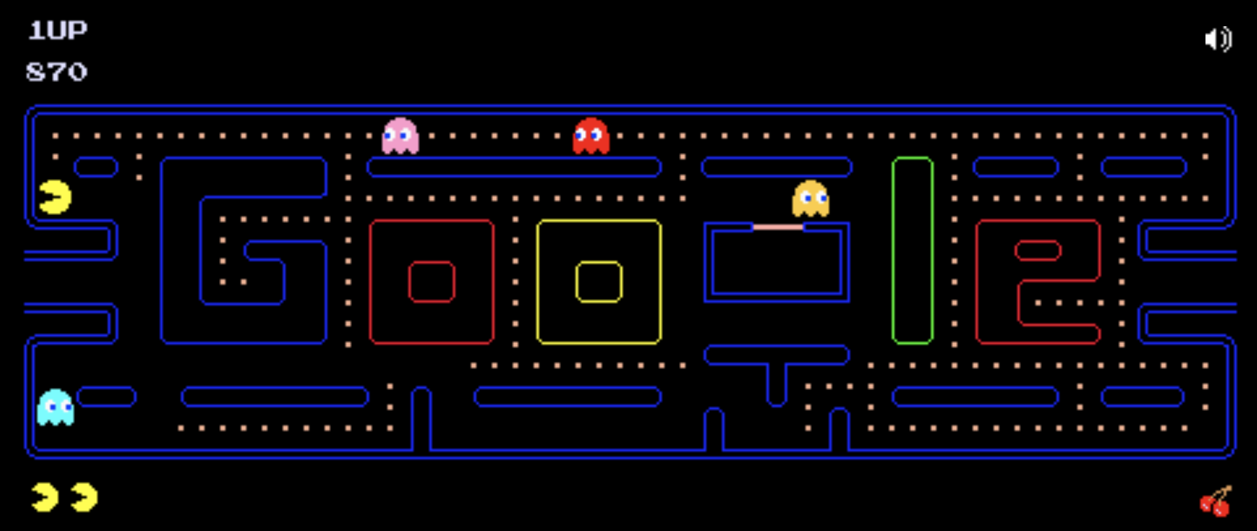
PACMAN
https://www.google.com/logos/2010/pacman10-i.html
Image from CS188 of Klein and Abbee

Slide 3
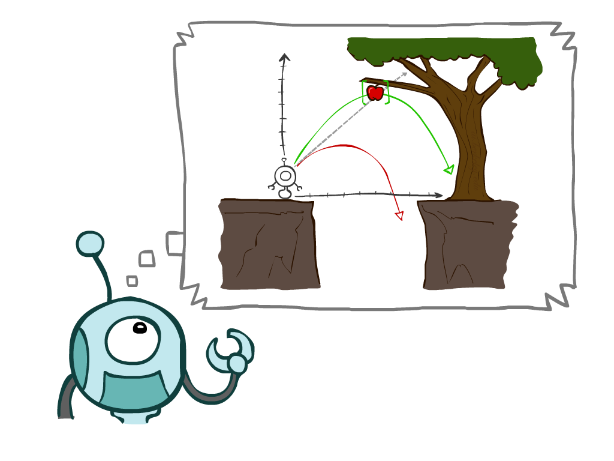
Keywords
Agents that plan ahead
Planning ~ Search
Problem representations
State Space Graph
Search Trees
Search Methods
DFS
BFS
Cost-Sensitive Search
Uniform Cost search
Image from CS188 of Klein and Abbee

Slide 4

Reflex Agents
Reflex agents:
Choose action based on current percept (and maybe memory)
May have memory or a model of the world’s current state
Do not consider the future consequences of their actions
Consider how the world “IS”
Consider how the thermostat works
If this, then that
Can a reflex agent be rational?
Image from CS188 of Klein and Abbee

Slide 5

Planning Agents
Planning agents:
Ask “what if”
Decisions based on (hypothesized) consequences of actions
Must have a model of how the world evolves in response to actions
Must formulate a goal (test)
Consider how the world “WOULD BE”
Optimal vs. complete planning
Planning vs. replanning
Image from CS188 of Klein and Abbee

Slide 6
Planning Agents
Planning agents:
Ask “what if”
Decisions based on (hypothesized) consequences of actions
Must have a model of how the world evolves in response to actions
Must formulate a goal (test)
Consider how the world “WOULD BE”
Optimal vs. complete planning
Planning vs. replanning
Image from CS188 of Klein and Abbee

Slide 7







Search Problems
A search problem consists of:
A state space
A successor function
(with actions, costs)
A start state and a goal test
A solution is a sequence of actions (a plan) which transforms the start state to a goal state
“N”, 1.0
“E”, 1.0
Slide credit: Klein and Abbee

Slide 8

Search Problems Are Models
Slide credit: Klein and Abbee

Slide 9
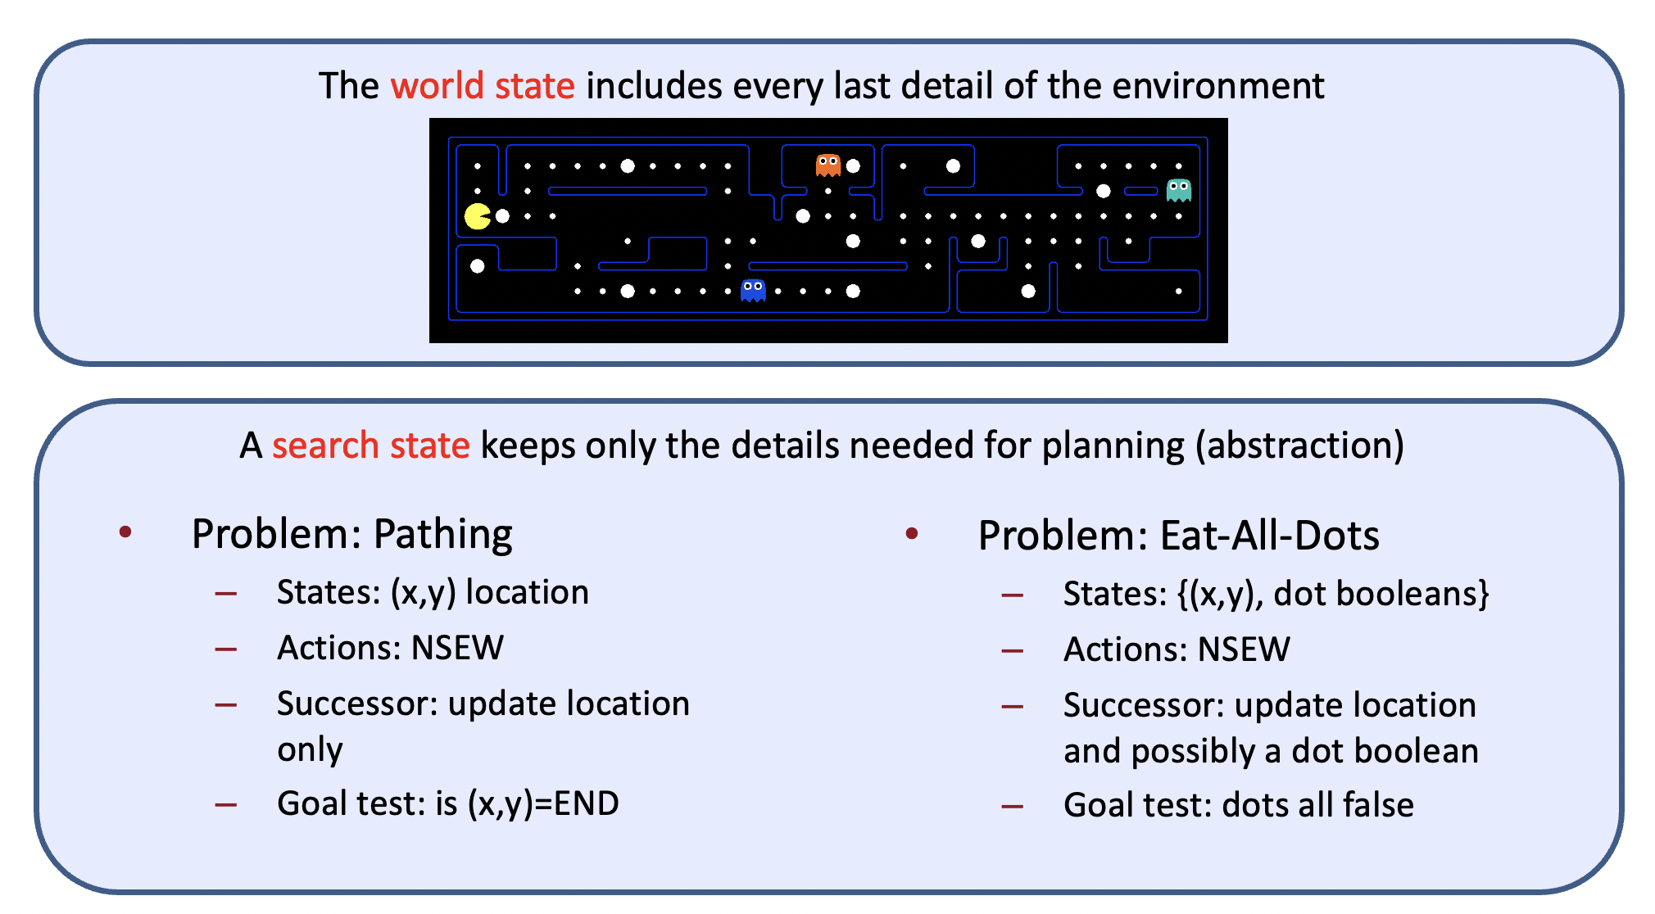
What’s in a State Space?
Slide credit: Klein and Abbee

Slide 10
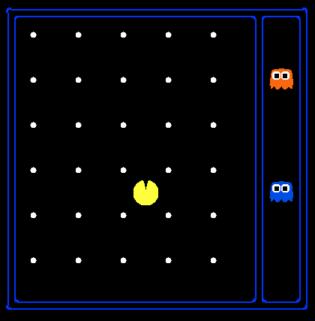
State Space Sizes?
World state:
Agent positions: 120
Food count: 30
Ghost positions: 12
Agent facing: NSEW
How many
World states?
120x(2³⁰)x(12²)x4
States for pathing?
120
States for eat-all-dots?
120x(2³⁰)
Slide credit: Klein and Abbee

Slide 11
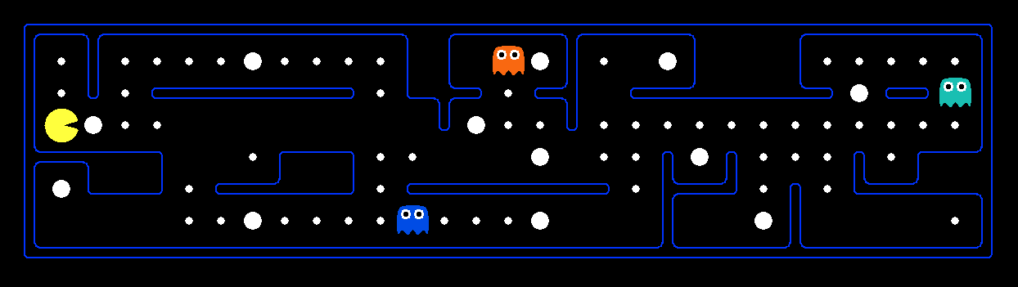
Quiz: Safe Passage
Problem: eat all dots while keeping the ghosts perma-scared
What does the state space have to specify?
(agent position, dot booleans, power pellet booleans, remaining scared time)
Slide credit: Klein and Abbee

Slide 12
State Space Graphs
State space graph: A mathematical representation of a search problem
Nodes are (abstracted) world configurations
Arcs represent successors (action results)
The goal test is a set of goal nodes (maybe only one)
In a state space graph, each state occurs only once!
We can rarely build this full graph in memory (it’s too big), but it’s a useful idea
Slide credit: Klein and Abbee

Slide 13
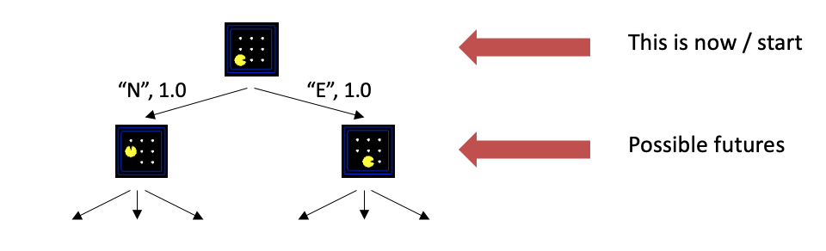
Search Trees
A search tree:
A “what if” tree of plans and their outcomes
The start state is the root node
Children correspond to successors
Nodes show states, but correspond to PLANS that achieve those states
For most problems, we can never actually build the whole tree
Slide credit: Klein and Abbee

Slide 14
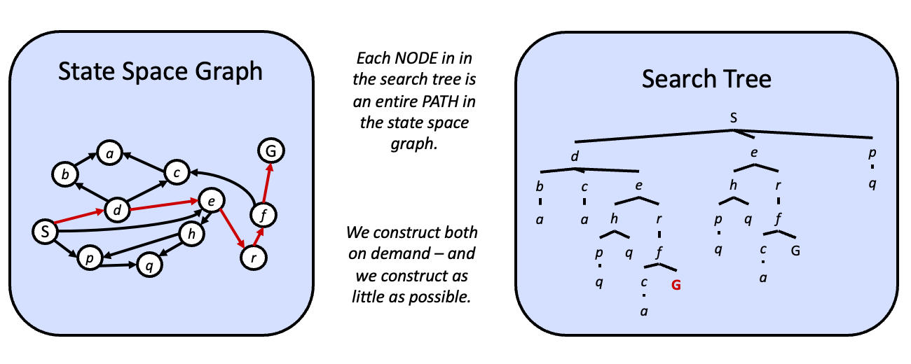
State Space Graphs vs. Search Trees
Slide credit: Klein and Abbee

Slide 15
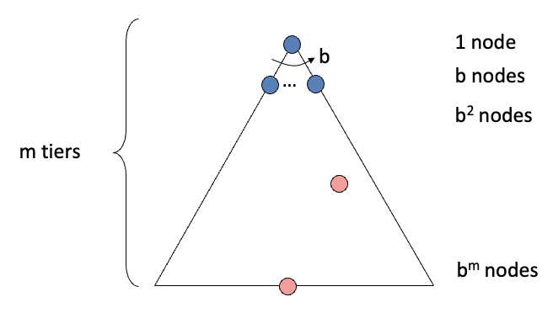
State Space Graphs
Complete: Guaranteed to find a solution if one exists?
Optimal: Guaranteed to find the least cost path?
Time complexity?
Space complexity?
Cartoon of search tree:
b is the branching factor
m is the maximum depth
solutions at various depths
Number of nodes in entire tree?
1 + b + b² + …. b^{m} = O(b^{m})
Slide credit: Klein and Abbee

Slide 16
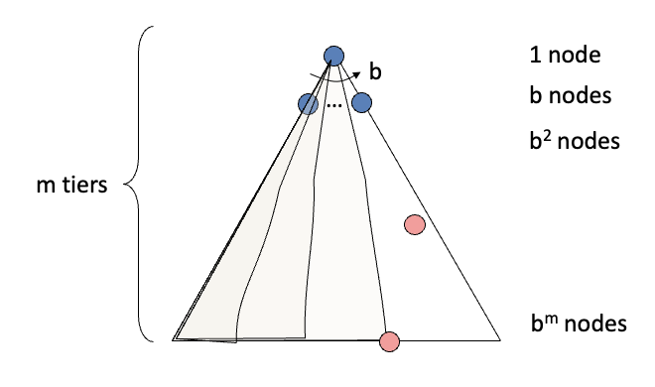
Depth-First Search (DFS) Properties
What nodes DFS expand?
Some left prefix of the tree.
Could process the whole tree!
If m is finite, takes time O(b^{m})
How much space does the fringe take?
Only has siblings on path to root, so O(bm)
Is it complete?
m could be infinite, so only if we prevent cycles (more later)
Is it optimal?
No, it finds the “leftmost” solution, regardless of depth or cost
Slide credit: Klein and Abbee

Slide 17
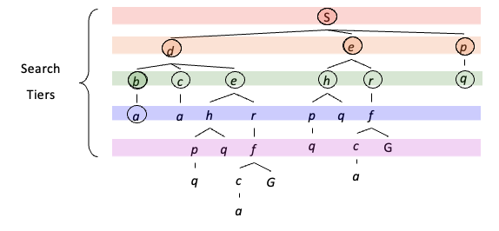
Breadth-First Search
a
G
b
c
Strategy: expand a shallowest node first
Implementation: Fringe is a FIFO queue
e
d
f
S
h
p
q
r
Slide credit: Klein and Abbee

Slide 18
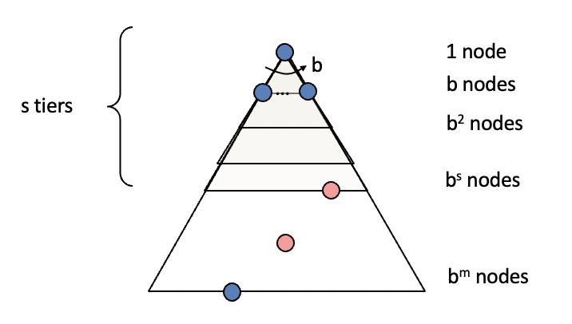
Breadth-First Search (BFS) Properties
What nodes does BFS expand?
Processes all nodes above shallowest solution
Let depth of shallowest solution be s
Search takes time O(b^{s})
How much space does the fringe take?
Has roughly the last tier, so O(b^{s})
Is it complete?
s must be finite if a solution exists, so yes!
Is it optimal?
Only if costs are all 1 (more on costs later)
Slide credit: Klein and Abbee

Slide 19
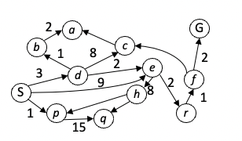
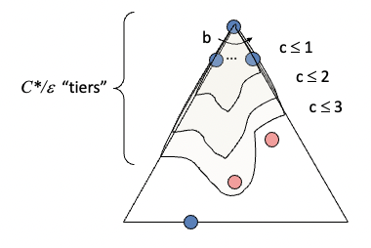
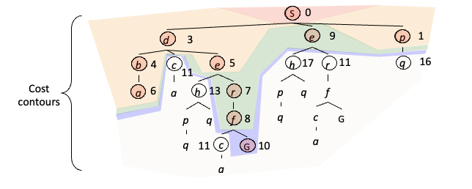
Uniform Cost Search
Strategy: expand a cheapest node first:
Fringe is a priority queue (priority: cumulative cost)
Slide credit: Klein and Abbee

Slide 20
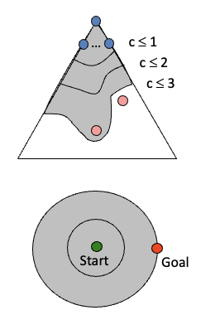
Uniform Cost Issue
Remember: UCS explores increasing cost contours
The good: UCS is complete and optimal!
The bad:
Explores options in every “direction”
No information about goal location
We’ll fix that soon!
Slide credit: Klein and Abbee

Slide 21

The One Queue
All these search algorithms are the same except for fringe strategies
Conceptually, all fringes are priority queues (i.e. collections of nodes with attached priorities)
Practically, for DFS and BFS, you can avoid the log(n) overhead from an actual priority queue, by using stacks and queues
Can even code one implementation that takes a variable queuing object
Slide credit: Klein and Abbee

Slide 22
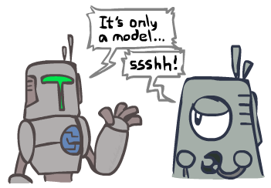
Search and Models
Search operates over models of the world
The agent doesn’t actually try all the plans out in the real world!
Planning is all “in simulation”
Your search is only as good as your models…
Slide credit: Klein and Abbee

